Slide 2
ÁLGEBRA
Ecuaciones polinomiales
Semana 02
Docente: Gustavo Poma Quiroz

Slide 3
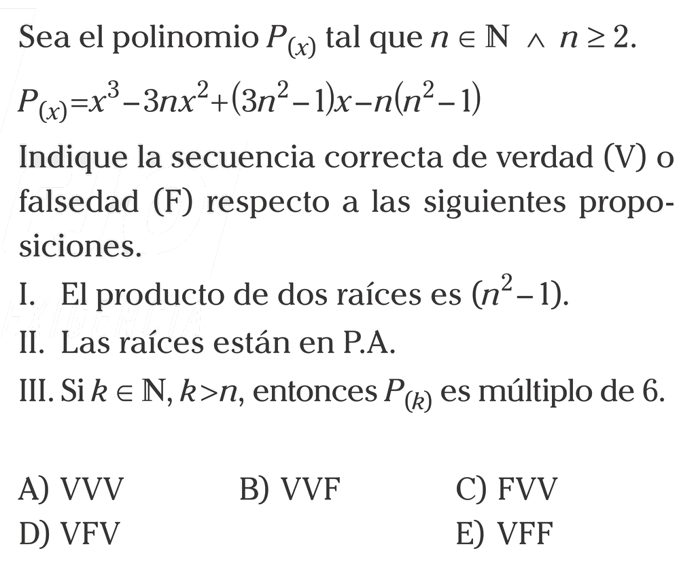






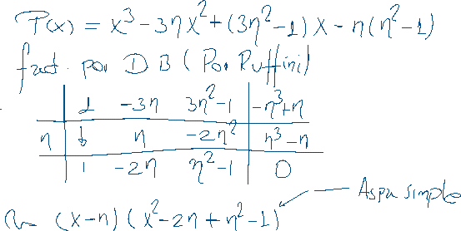






24.
Resolución

Slide 4





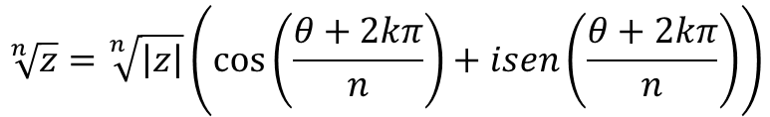

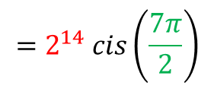


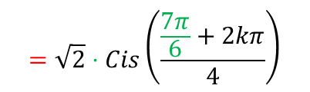














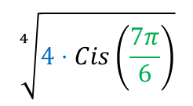



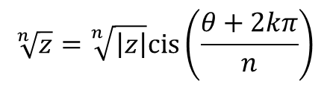


Ejemplos:
TEOREMA (DE MOIVRÉ)
${\left(cos36°+i⋅sen36°\right)}^{5}$
Dado el número complejo no nulo
$$=$$
$$cos\left(5∙36°\right)+i⋅sen\left(5∙36°\right)$$
$$=$$
$$−1+0⋅i$$
$$z= \left|z\right|\left(cosθ+isenθ\right)$$
$$=\left|z\right|Cis(θ)$$
$$=\left|z\right|e^{θi}$$
$$\left(n∈ℕ \right)$$
${\left[\sqrt{2} cis\frac{π}{8} \right]}^{28}$
$$={\sqrt{2}}^{28}$$
$$cis \left(28∙\frac{π}{8}\right)$$
$$=2^{14} cis\left(\frac{7π}{2}\right)$$
Se tiene:
$$=2^{14}$$
$$1)$$
$$z^{n}= {\left|z\right|}^{n}\left[cos⁡(nθ)+isen(nθ)\right]$$
${\left[\sqrt{5}e^{\frac{7π}{4}i} \right]}^{6}$
$$={\sqrt{5}}^{6}$$
$$e^{6∙\frac{7π}{4}i}$$
$$={125 e}^{\frac{21π}{2} i}$$
$$=125 i$$
$$z^{n}= {\left|z\right|}^{n}Cis(nθ)$$
$$= {\left|z\right|}^{n}e^{(nθ)i}$$
Encuentre las raíces de:
$$\sqrt[n]{z}=\sqrt[n]{\left|z\right|}\left(\cos\left(\frac{θ+2kπ}{n}\right)+isen\left(\frac{θ+2kπ}{n}\right)\right)$$
$$2)$$
$$\sqrt[4]{4⋅Cis\left(\frac{7π}{6}\right)}$$
$$=\sqrt{2}⋅Cis\left(\frac{\frac{7π}{6}+2kπ}{4}\right)$$
$w=\sqrt[4]{−2\sqrt{2}−2i}$ =
$$\sqrt[n]{z}=\sqrt[n]{\left|z\right|}cis\left(\frac{θ+2kπ}{n}\right)$$
$$=\sqrt[n]{\left|z\right|}.e^{\left(\frac{θ+2kπ}{n}\right)i}$$
Donde $k: 0;1;2;3$
$$donde k=0, 1, 2, …, n−1.$$

Slide 5
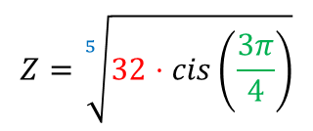






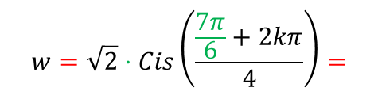
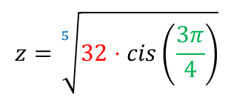

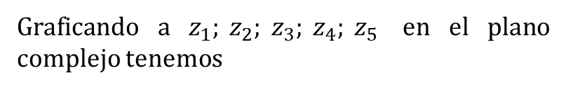







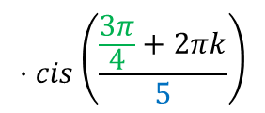

















$$k=0 ;$$
$w_{0}=\sqrt{2}⋅Cis\left(\frac{7π}{24}\right)$
Graficando a $z_{1}; z_{2}; z_{3}; z_{4}; z_{5}$ en el plano complejo tenemos
$$w=\sqrt{2}⋅Cis\left(\frac{\frac{7π}{6}+2kπ}{4}\right)=$$
$$k=1 ;$$
$w_{1}=\sqrt{2}⋅Cis\left(\frac{19π}{24}\right)$
$$Im$$
$$k=2 ;$$
$w_{2}=\sqrt{2}⋅Cis\left(\frac{31π}{24}\right)$
$$z_{2}$$
$$k=3 ;$$
$w_{3}=\sqrt{2}⋅Cis\left(\frac{43π}{24}\right)$
$$2$$
$$\frac{2π}{5}$$
$$z_{1}$$
Encuentre las raíces y represéntelas en el plano complejo
$$z_{3}$$
$$z=\sqrt[5]{32⋅cis\left(\frac{3π}{4}\right)}$$
$$⋅cis\left(\frac{\frac{3π}{4}+2πk}{5}\right)$$
$$=\sqrt[5]{32}$$
$$; k=0, 1, 2. 3, 4.$$
$$Re$$
$$=\left\{\begin{aligned}3cis\left(2π/15\right) \\ \\ 3cis\left(8π/15\right) \\ \begin{matrix}3cis\left(14π/15\right) \\ 3cis\left(20π/15\right) \\ 3cis\left(26π/15\right)\end{matrix}\end{aligned}\right.$$
$$k=0 ;$$
$$z_{1}=2⋅cis\left(3π/20\right)$$
$$z_{5}$$
$$z_{4}$$
$$k=1 ;$$
$$z_{2} \text{=}2⋅cis\left(11π/20\right)$$
$$Z=\sqrt[5]{32⋅cis\left(\frac{3π}{4}\right)}$$
$k=2$ ;
$$z_{3}=2⋅cis\left(19π/20\right)$$
$$k=3 ;$$
$$z_{4}=2⋅cis\left(27π/20\right)$$
El pentágono generado $z_{1}{, z}_{2},z_{3}, z_{4}$ y $z_{5}$ es regular.
$$k=4 ;$$
$$z_{5}=2⋅cis\left(35π/20\right)$$

